Slide 1
Atomic Layer Deposition (ALD)

Slide 2
Presentation Overview
Definition of ALD
Brief history of ALD
ALD process and equipments
ALD applications
Summary

Slide 3
Definition of ALD
ALD is a method of applying thin films to various substrates with atomic scale precision.
Similar in chemistry to chemical vapor deposition (CVD), except that the ALD reaction breaks the CVD reaction into two half-reactions, keeping the precursor materials separate during the reaction.
ALD film growth is self-limited and based on surface reactions, which makes achieving atomic scale deposition control possible.
By keeping the precursors separate throughout the coating process, atomic layer thickness control of film grown can be obtained as fine as atomic/molecular scale per monolayer.
Ref: "Atomic Layer Deposition," Wikipedia: The Free Encyclopedia, Wikimedia Foundation, 24 April 06. <http://en.wikipedia.org/wiki/Atomic_Layer_Deposition>.

Slide 4
Definition of ALD
ALD is a method of applying thin films to various substrates with atomic scale precision.
Similar in chemistry to CVD, except that the ALD reaction breaks the CVD reaction into two half-reactions, keeping the precursor materials separate during the reaction.
ALD film growth is self-limited and based on surface reactions, which makes achieving atomic scale deposition control possible.
By keeping the precursors separate throughout the coating process, atomic layer thickness control of film grown can be obtained as fine as atomic/molecular scale per monolayer.
Ref: "Atomic Layer Deposition," Wikipedia: The Free Encyclopedia, Wikimedia Foundation, 24 April 06. <http://en.wikipedia.org/wiki/Atomic_Layer_Deposition>.

Slide 5
Definition of ALD
ALD is a method of applying thin films to various substrates with atomic scale precision.
Similar in chemistry to chemical vapor deposition (CVD), except that the ALD reaction breaks the CVD reaction into two half-reactions, keeping the precursor materials separate during the reaction.
ALD film growth is self-limited and based on surface reactions, which makes achieving atomic scale deposition control possible.
By keeping the precursors separate throughout the coating process, atomic layer thickness control of film grown can be obtained as fine as atomic/molecular scale per monolayer.
Ref: "Atomic Layer Deposition," Wikipedia: The Free Encyclopedia, Wikimedia Foundation, 24 April 06. <http://en.wikipedia.org/wiki/Atomic_Layer_Deposition>.

Slide 6
Definition of ALD
ALD is a method of applying thin films to various substrates with atomic scale precision.
Similar in chemistry to chemical vapor deposition (CVD), except that the ALD reaction breaks the CVD reaction into two half-reactions, keeping the precursor materials separate during the reaction.
ALD film growth is self-limited and based on surface reactions, which makes achieving atomic scale deposition control possible.
By keeping the precursors separate throughout the coating process, atomic layer thickness control of film grown can be obtained as fine as atomic/molecular scale per monolayer.
Ref: "Atomic Layer Deposition," Wikipedia: The Free Encyclopedia, Wikimedia Foundation, 24 April 06. <http://en.wikipedia.org/wiki/Atomic_Layer_Deposition>.

Slide 7
Brief History of ALD
Introduced in 1974 by Dr. Tuomo Suntola and co-workers in Finland to improve the quality of ZnS films used in electroluminescent displays.
Recently, it turned out that ALD also produces outstanding dielectric layers and attracts semiconductor industries for making High-K dielectric materials.
Ref: "History of Atomic Layer Deposition (ALD)," Finnish MicroNanoTechnology Network (FMNT), 24 April 2006. <http://www.fmnt.fi/index.pl?id=2913&isa=Category&op=show>.

Slide 8
Brief History of ALD
Introduced in 1974 by Dr. Tuomo Suntola and co-workers in Finland to improve the quality of ZnS films used in electroluminescent displays.
Recently, it turned out that ALD method also produces outstanding dielectric layers and attracted semiconductor industries for making High-K dielectric materials.
Ref: "History of Atomic Layer Deposition (ALD)," Finnish MicroNanoTechnology Network (FMNT), 24 April 2006. <http://www.fmnt.fi/index.pl?id=2913&isa=Category&op=show>.

Slide 9
ALD Process and Equipments
Releases sequential precursor gas pulses to deposit a film one layer at a time on the substrate.
The precursor gas is introduced into the process chamber and produces a monolayer of gas on the wafer surface. A second precursor of gas is then introduced into the chamber reacting with the first precursor to produce a monolayer of film on the wafer surface.
Two fundamental mechanisms:
  Chemisorption saturation process
  Sequential surface chemical reaction process
Example: ALD cycle for Al₂O₃ deposition
Since each pair of gas pulses (one cycle) produces exactly one monolayer of film, the thickness of the resulting film may be precisely controlled by the number of deposition cycles.
Ref: A. Knop–Gericke, "Preparation of Model Systems by Physical Methods," a lecture given at Modern Methods in Heterogeneous Catalysis Research Lecture Series, Fritz Haber Institute of the Max Planck Society. 24 April 06.
<http://w3.rz-berlin.mpg.de/%7Ejentoft/lehre/catalysis0405.html>.

Slide 10
ALD Process and Equipments
Releases sequential precursor gas pulses to deposit a film one layer at a time.
A first precursor gas is introduced into the process chamber and produces a monolayer of gas on the wafer surface. Then a second precursor of gas is introduced into the chamber reacting with the first precursor to produce a monolayer of film on the wafer surface.
Two fundamental mechanisms:
  Chemisorption saturation process
  Sequential surface chemical reaction process
Example: ALD cycle for Al₂O₃ deposition
Since each pair of gas pulses (one cycle) produces exactly one monolayer of film, the thickness of the resulting film may be precisely controlled by the number of deposition cycles.
Ref: A. Knop–Gericke, "Preparation of Model Systems by Physical Methods," a lecture given at Modern Methods in Heterogeneous Catalysis Research Lecture Series, Fritz Haber Institute of the Max Planck Society. 24 April 06.
<http://w3.rz-berlin.mpg.de/%7Ejentoft/lehre/catalysis0405.html>.

Slide 11
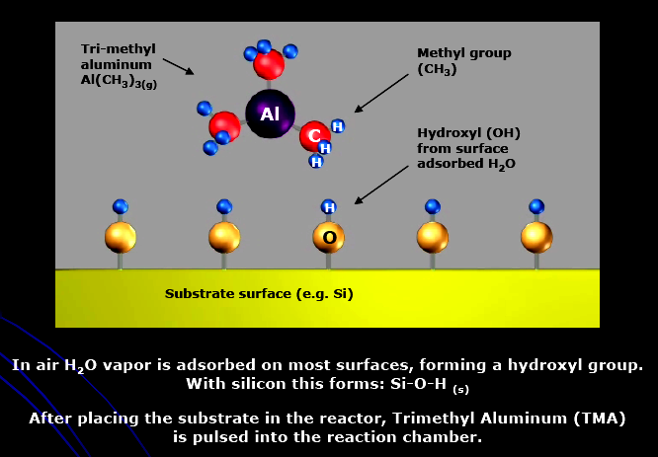
ALD Process and Equipments
Releases sequential precursor gas pulses to deposit a film one layer at a time.
A first precursor gas is introduced into the process chamber and produces a monolayer of gas on the wafer surface. Then a second precursor of gas is introduced into the chamber reacting with the first precursor to produce a monolayer of film on the wafer surface.
Two fundamental mechanisms:
  Chemisorption saturation process
  Sequential surface chemical reaction process
Example: ALD cycle for Al₂O₃ deposition (Step 1a)
Ref: "Atomic Layer Deposition," Cambridge NanoTech Inc., 24 April 06. <http://www.cambridgenanotech.com/>.

Slide 12
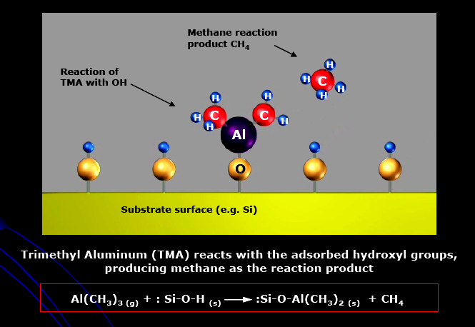
ALD Process and Equipments
Releases sequential precursor gas pulses to deposit a film one layer at a time.
A first precursor gas is introduced into the process chamber and produces a monolayer of gas on the wafer surface. Then a second precursor of gas is introduced into the chamber reacting with the first precursor to produce a monolayer of film on the wafer surface.
Two fundamental mechanisms:
  Chemisorption saturation process
  Sequential surface chemical reaction process
Example: ALD cycle for Al₂O₃ deposition (Step 1b)
Ref: "Atomic Layer Deposition," Cambridge NanoTech Inc., 24 April 06. <http://www.cambridgenanotech.com/>.

Slide 13
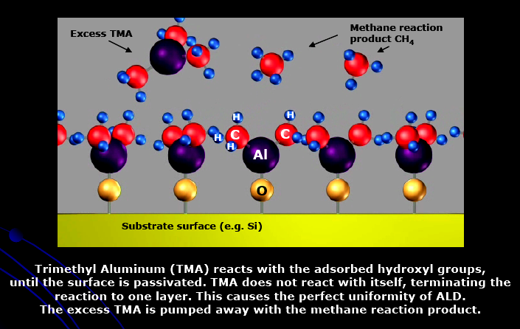
ALD Process and Equipments
Releases sequential precursor gas pulses to deposit a film one layer at a time.
A first precursor gas is introduced into the process chamber and produces a monolayer of gas on the wafer surface. Then a second precursor of gas is introduced into the chamber reacting with the first precursor to produce a monolayer of film on the wafer surface.
Two fundamental mechanisms:
  Chemisorption saturation process
  Sequential surface chemical reaction process
Example: ALD cycle for Al₂O₃ deposition (Step 1c)
Ref: "Atomic Layer Deposition," Cambridge NanoTech Inc., 24 April 06. <http://www.cambridgenanotech.com/>.

Slide 14
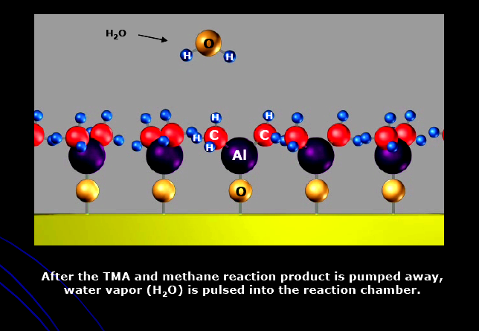
ALD Process and Equipments
Releases sequential precursor gas pulses to deposit a film one layer at a time.
A first precursor gas is introduced into the process chamber and produces a monolayer of gas on the wafer surface. Then a second precursor of gas is introduced into the chamber reacting with the first precursor to produce a monolayer of film on the wafer surface.
Two fundamental mechanisms:
  Chemisorption saturation process
  Sequential surface chemical reaction process
Example: ALD cycle for Al₂O₃ deposition (Step 2a)
Ref: "Atomic Layer Deposition," Cambridge NanoTech Inc., 24 April 06. <http://www.cambridgenanotech.com/>.

Slide 15
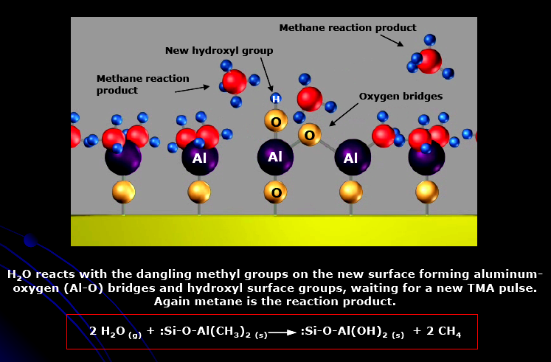
ALD Process and Equipments
Releases sequential precursor gas pulses to deposit a film one layer at a time.
A first precursor gas is introduced into the process chamber and produces a monolayer of gas on the wafer surface. Then a second precursor of gas is introduced into the chamber reacting with the first precursor to produce a monolayer of film on the wafer surface.
Two fundamental mechanisms:
  Chemisorption saturation process
  Sequential surface chemical reaction process
Example: ALD cycle for Al₂O₃ deposition (Step 2b)
Ref: "Atomic Layer Deposition," Cambridge NanoTech Inc., 24 April 06. <http://www.cambridgenanotech.com/>.

Slide 16
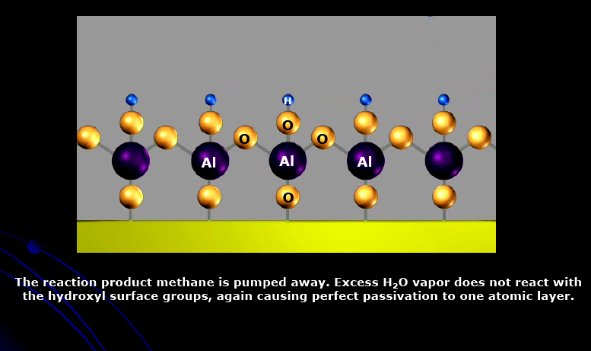
ALD Process and Equipments
Releases sequential precursor gas pulses to deposit a film one layer at a time.
A first precursor gas is introduced into the process chamber and produces a monolayer of gas on the wafer surface. Then a second precursor of gas is introduced into the chamber reacting with the first precursor to produce a monolayer of film on the wafer surface.
Two fundamental mechanisms:
  Chemisorption saturation process
  Sequential surface chemical reaction process
Example: ALD cycle for Al₂O₃ deposition (Step 2c)
Ref: "Atomic Layer Deposition," Cambridge NanoTech Inc., 24 April 06. <http://www.cambridgenanotech.com/>.

Slide 17
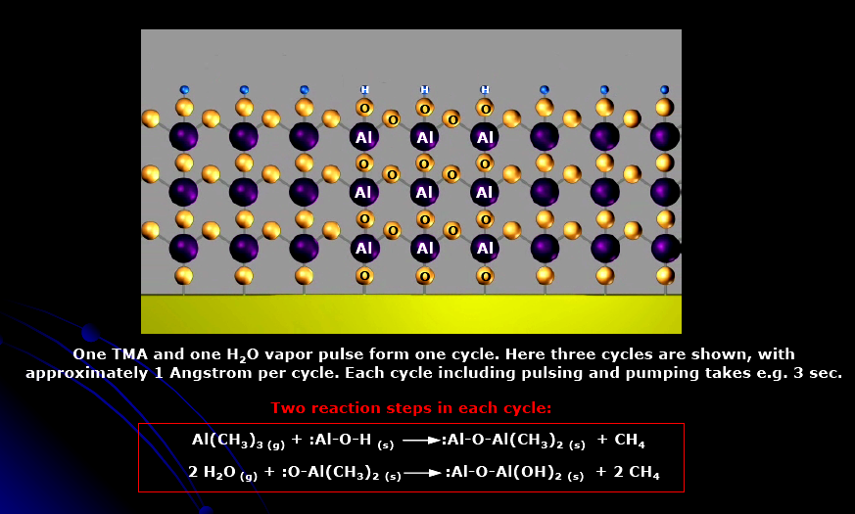
ALD Process and Equipments
Releases sequential precursor gas pulses to deposit a film one layer at a time.
A first precursor gas is introduced into the process chamber and produces a monolayer of gas on the wafer surface. Then a second precursor of gas is introduced into the chamber reacting with the first precursor to produce a monolayer of film on the wafer surface.
Two fundamental mechanisms:
  Chemisorption saturation process
  Sequential surface chemical reaction process
Example: ALD cycle for Al₂O₃ deposition (after 3 cycles)
Ref: "Atomic Layer Deposition," Cambridge NanoTech Inc., 24 April 06. <http://www.cambridgenanotech.com/>.

Slide 18
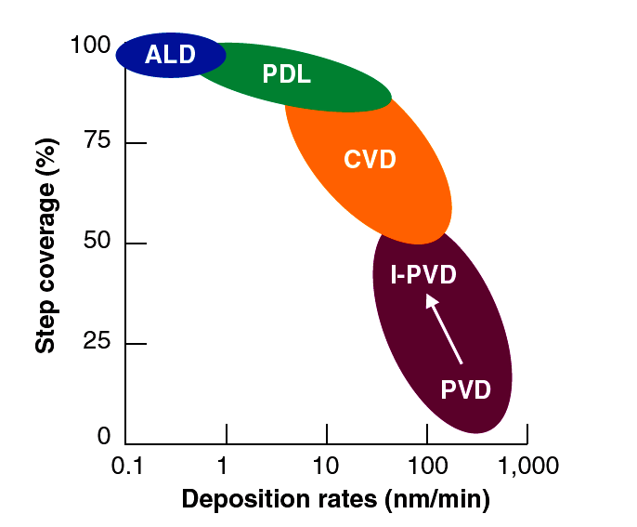
ALD Process and Equipments
Releases sequential precursor gas pulses to deposit a film one layer at a time.
A first precursor gas is introduced into the process chamber and produces a monolayer of gas on the wafer surface. Then a second precursor of gas is introduced into the chamber reacting with the first precursor to produce a monolayer of film on the wafer surface.
Two fundamental mechanisms:
  Chemisorption saturation process
  Sequential surface chemical reaction process
Example: ALD cycle for Al₂O₃ deposition
Since each pair of gas pulses (one cycle) produces exactly one monolayer of film, the thickness of the resulting film may be precisely controlled by the number of deposition cycles.
Step coverage and deposition rate Vs.
deposition technique.
Ref: "Technology Backgrounder: Atomic Layer Deposition," IC Knowledge LLC, 24 April 06. <www.icknowledge.com/misc_technology/Atomic%20Layer%20Deposition%20Briefing.pdf>.

Slide 19
ALD Process and Equipments
Four main types of ALD reactors
Closed system chambers
Open system chambers
Semi-closed system chambers
Semi-open system chambers

Slide 20
ALD Process and Equipments
Four main types of ALD reactors
Closed system chambers (most common)
Open system chambers
Semi-closed system chambers
Semi-open system chambers
✓

Slide 21
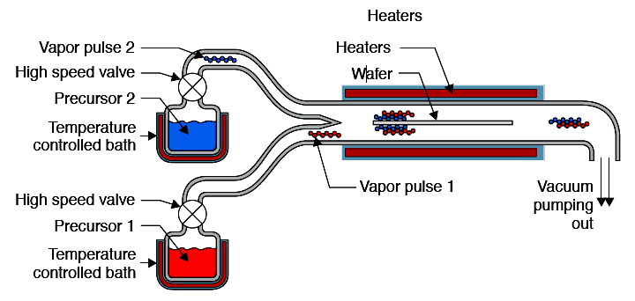
ALD Process and Equipments
Four main types of ALD reactors
Closed system chambers (most common)
  The reaction chamber walls are designed to effect the transport of the precursors.
Schematic of
a closed ALD system
Open system chambers
Semi-closed system chambers
Semi-open system chambers
Ref: "Technology Backgrounder: Atomic Layer Deposition," IC Knowledge LLC, 24 April 06. <www.icknowledge.com/misc_technology/Atomic%20Layer%20Deposition%20Briefing.pdf>.

Slide 22
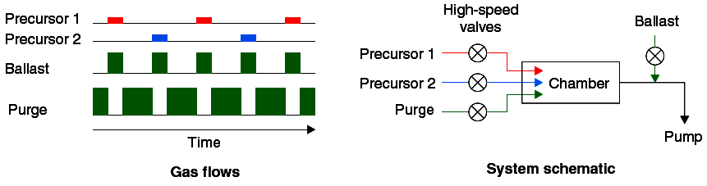
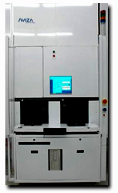
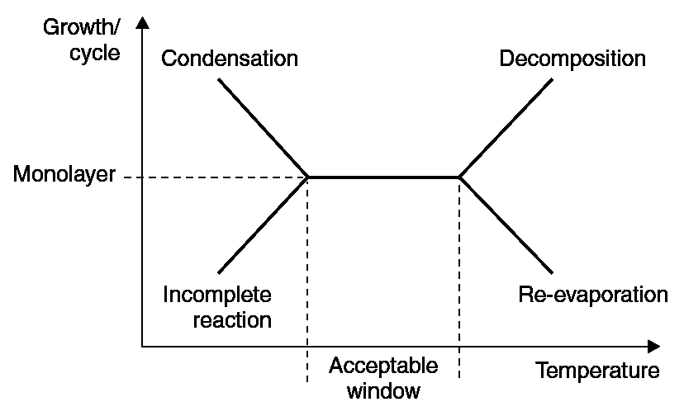
ALD Process and Equipments
[1]
[1]
The Verano 5500™
A 300-mm ALD system by
Aviza Technology, Inc [2].
Process Temperature [1]
¹ "Technology Backgrounder: Atomic Layer Deposition," IC Knowledge LLC, 24 April 06. <www.icknowledge.com/misc_technology/Atomic%20Layer%20Deposition%20Briefing.pdf>
² ”Atomic Layer Deposition," Aviza Technology. 26 April 06. <http://www.avizatechnology.com/products/verano.shtml>.

Slide 23
ALD Process and Equipments
One cycle
[1]
[1]
The Verano 5500™
A 300-mm ALD system by
Aviza Technology, Inc [2].
Acceptable temperature range for deposition.
Process Temperature [1]
¹ "Technology Backgrounder: Atomic Layer Deposition," IC Knowledge LLC, 24 April 06. <www.icknowledge.com/misc_technology/Atomic%20Layer%20Deposition%20Briefing.pdf>.
² ”Atomic Layer Deposition," Aviza Technology. 26 April 06. <http://www.avizatechnology.com/products/verano.shtml>.

Slide 24
ALD Applications
High-K dielectrics for CMOS
Semiconductor memory (DRAM)
Cu interconnect barrier
Deposition in porous structures

Slide 25
ALD Applications
✓
High-K dielectrics for CMOS
Semiconductor memory (DRAM)
Cu interconnect barrier
Deposition in porous structures

Slide 26
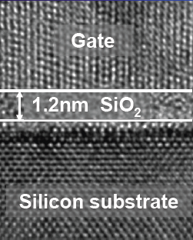
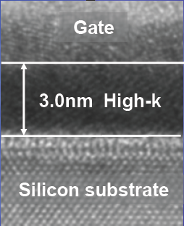
ALD Applications
High-K dielectrics for CMOS
Reduces leakage current
Faster switching speed
Cooler transistors
Candidates for High-K dielectrics
Film Precursors
Al₂O₃ Al(CH)₃, H₂O or O₃
HfO₂ HfCl₄ or TEMAH, H₂O
ZrO₂ ZrCl₄, H₂O
Ref: "Intel's High-k/Metal Gate Announcement," Intel® Corporation. 26 April, 06. <http://www.intel.com/technology/silicon/micron.htm#high>.

Slide 27
ALD Applications
High-K dielectrics for CMOS
Semiconductor memory (DRAM)
Cu interconnect barrier
Deposition in porous structures
All these applications take advantage of uniformity, conformal step coverage, precise thickness control of deposited films, which can be achieved by ALD deposition method.
Step coverage and deposition rate Vs.
deposition technique.
Ref: "Technology Backgrounder: Atomic Layer Deposition," IC Knowledge LLC, 24 April 06. <www.icknowledge.com/misc_technology/Atomic%20Layer%20Deposition%20Briefing.pdf>.

Slide 28
Summary
Advantages
  Stoichiometric films with large area uniformity and 3D conformality.
  Precise thickness control.
  Low temperature deposition possible.
  Gentle deposition process for sensitive substrates.
Disadvantages
  Deposition Rate slower than CVD.
  Number of different material that can be deposited is fair compared to MBE.

